Slide 1

Helmet and License Plate Detection
Bigyapti Bashyal (076BCT016)
Bivek Shrestha (076BCT020)
Ishani Malla (076BCT028)

Slide 2
Content
01
Objective
02
Task Completed before
03
Task Completed
04
Task remaining

Slide 3
Objectives
Detect Helmets
Detect license plates
Automatic extraction of license plates in those without helmet

Slide 4
Task completed before
Data Collection
Data Annotation and pre-processing
Character Segmentation
OCR model using CNN

Slide 5
Task completed before
Data Collection
Around 100 recordings of CCTV footage was obtained from Jawalakhel Police Department.

Slide 6
Task completed before
Data annotation and processing
Extracting frames from videos
Annotation with bounding boxes using roboflow
Data augmentation
2,827 images and annotations were done for the license plate class

Slide 7
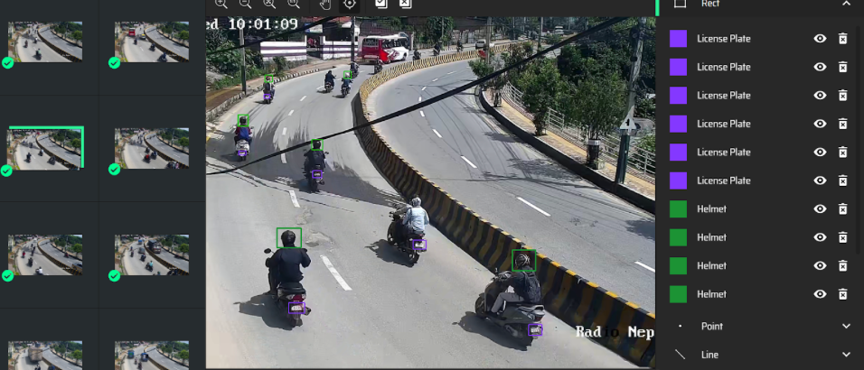
Dataset Pre-Processing

Slide 8
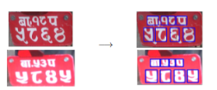
Task completed before
Character Segmentation
Done using OpenCV

Slide 9
Task completed before
License plate character recognition(OCR)
Dataset includes 2033 images labeled from 0 to pa.
Done using CNN (Classification model)

Slide 10
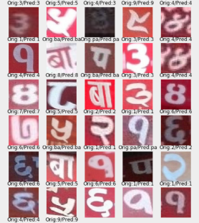
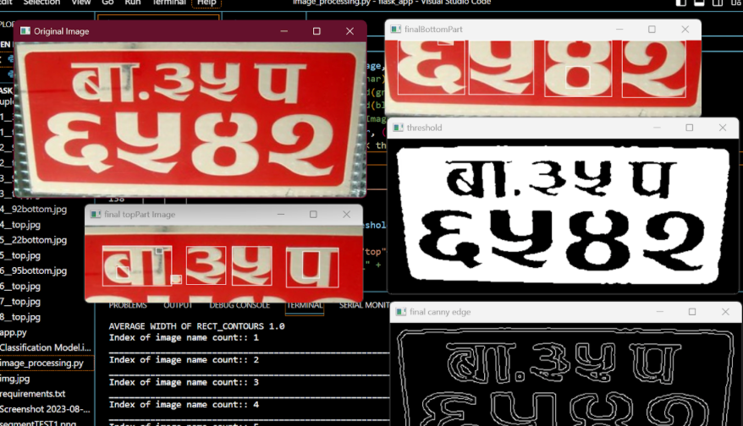
Task completed before

Slide 11
Task completed now
Improvised Dataset (manual collection)
License plate detection (yolov8)
Helmet detection (yolov8)
Improvised character segmentation(yolov8)
Improvised Character recognition(yolov8 labels)
Integration of detection,segmentation and recognition

Slide 12
Task completed
Improvised Dataset (manual collection)
using only CCTV footage did not add versitality in the dataset so manual collection was done throughout kathmandu valley using Canon DSLR camera

Slide 13
Task completed
License plate detection (yolov8)
License plate Dataset was fed into yolov8 for detection
train set 1983 images
valid set 588 images
test set 286 images
trained for 100 epochs
training was stopped when no further decrease in loss was observed

Slide 14
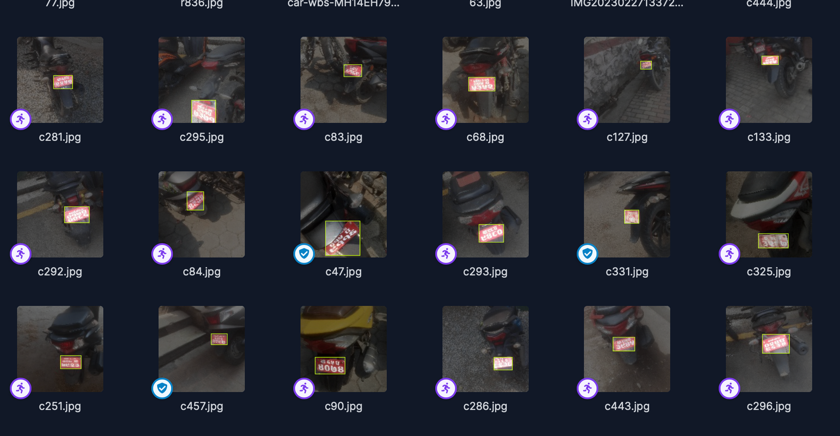
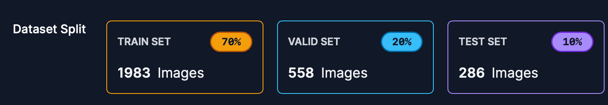
License plate Dataset

Slide 15
Task completed
Helmet detection
Helmet detection (yolov8)
Helmet Dataset was fed into yolov8 for detection
train set 1722 images
valid set 125 images
test set 125 images
trained for 110 epochs
auto-orient and horizontal flip were applied

Slide 16
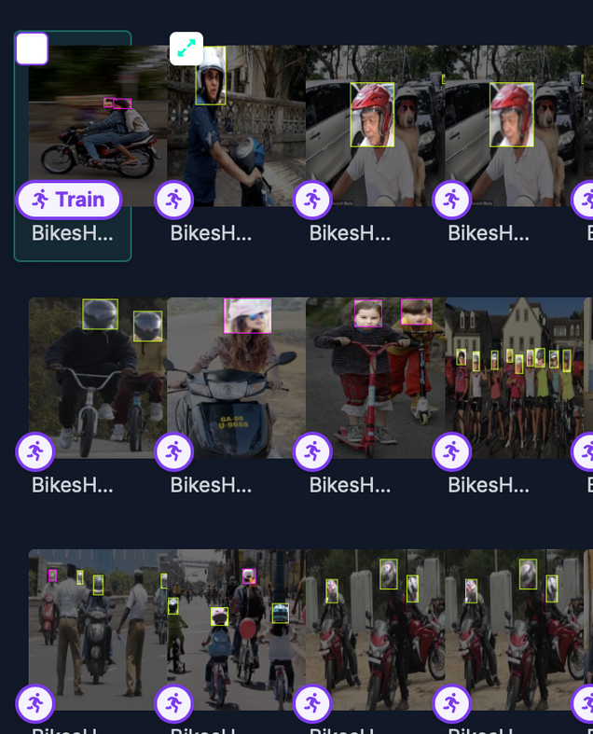
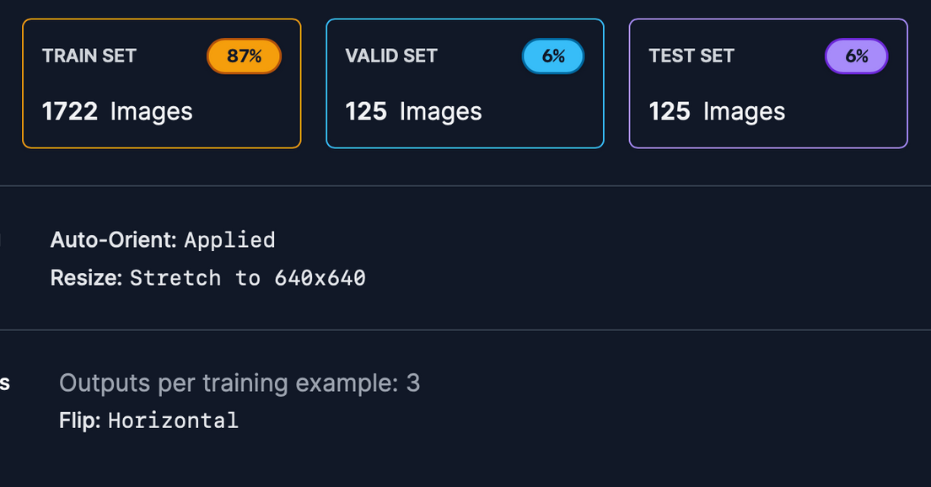
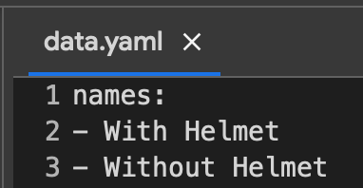

Slide 17
Task completed
Improvised character segmentation(yolov8)
Segmented character dataset was fed into yolov8 for detection
train set 876 images
valid set 40 images
test set 20 images
trained for 105 epochs
crop, auto-orient,rotation, shear, hue, adjust brightness and exposure steps were applied

Slide 18
Task completed
Improvised Character recognition(yolov8 labels)
The class labels from the character segmentation model were used to recognize the individual characters.

Slide 19
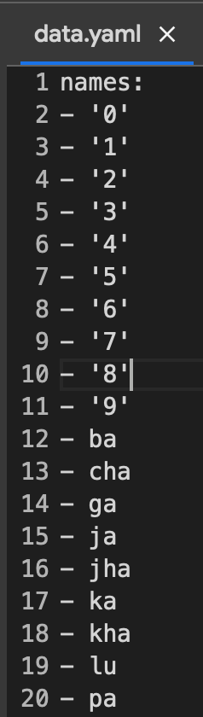
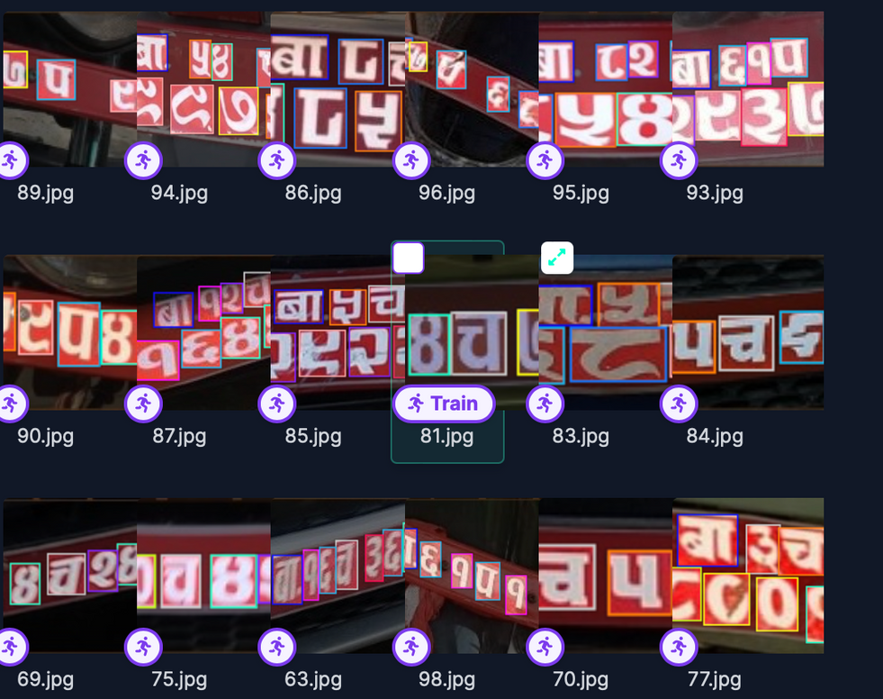
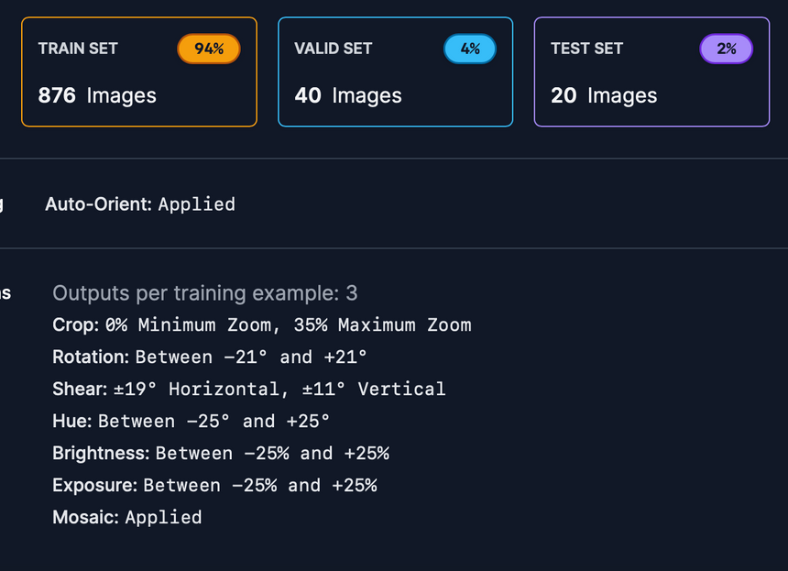

Slide 20
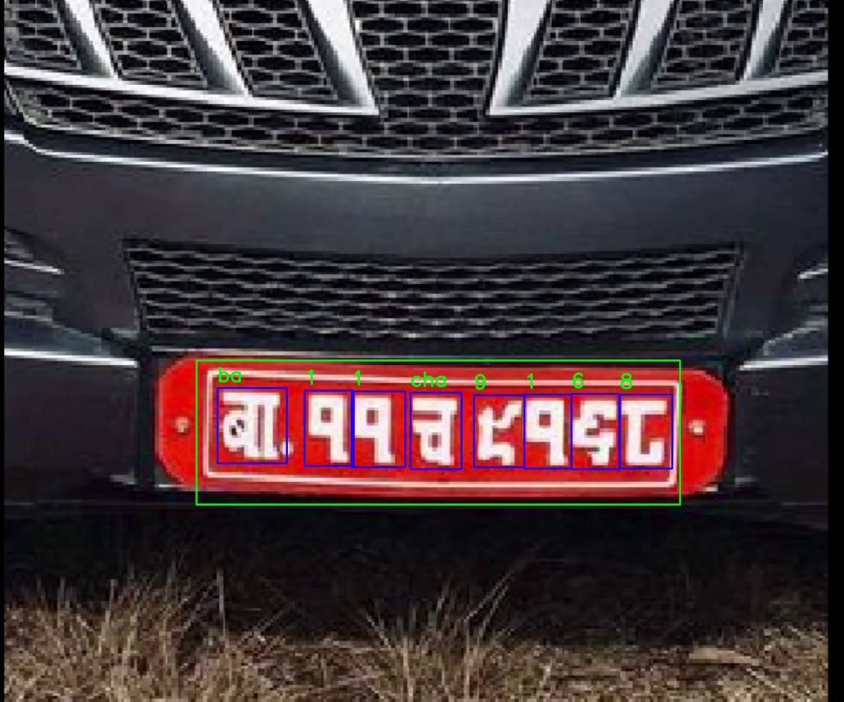
Integration of detection,segmentation and recognition
Integration of detection,segmentation and recognition

Slide 21
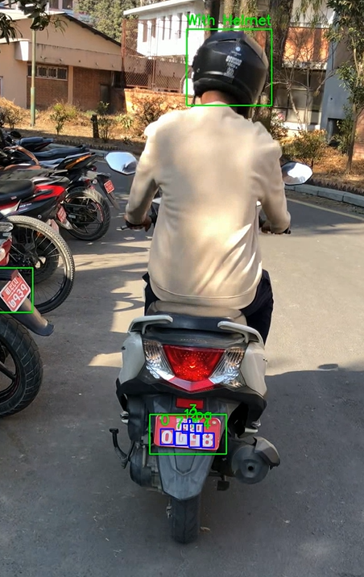
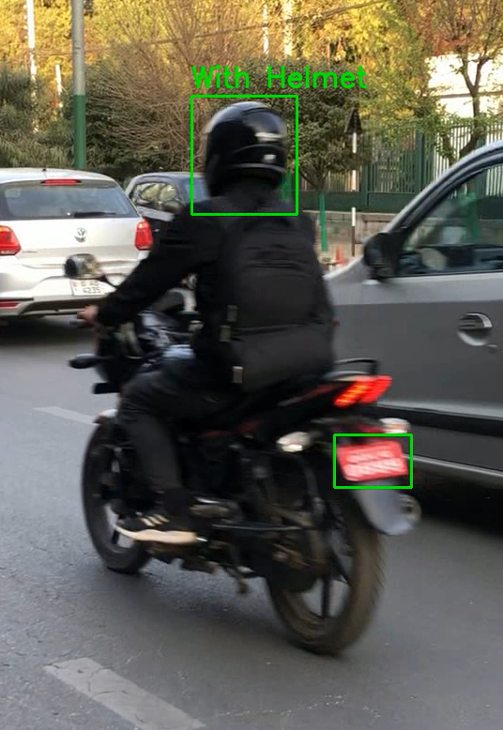
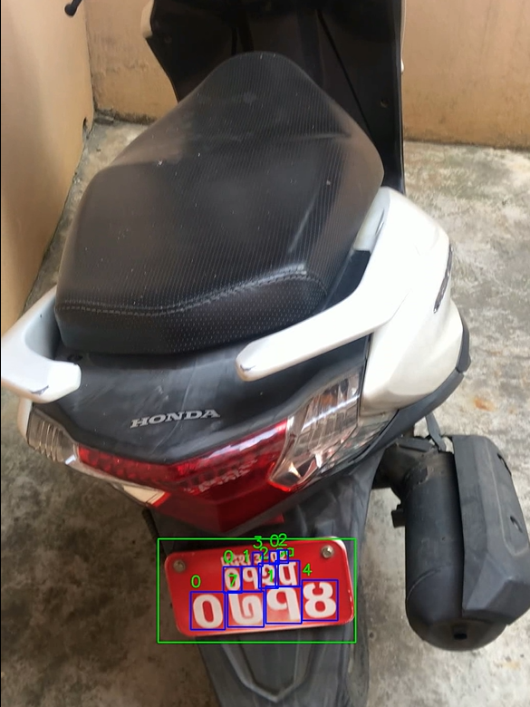

Slide 22
Task remaining
Object tracking using deepsort is yet to be done
Evaluating and improsiving yolo model accuracy is yet to be done
Web interface is yet to be made
Automatic extraction of license plates in those without helmet by capturing frame is yet to be done

Slide 23
Thank You

